Slide 1
Braceloc project

Slide 2
Summary
Technical Introduction
Technical Solutions
Planning
Conclusion
Usage scenario

Slide 3
Presentation
Real-time location tracking, sharing
GPS position exchange
Emergency communication
No network coverage dependency
skin sensor integration
Objective: Enable offline location tracking and distress alerting for friends, family, and group members while ensuring the privacy of their positions from other groups.

Slide 4
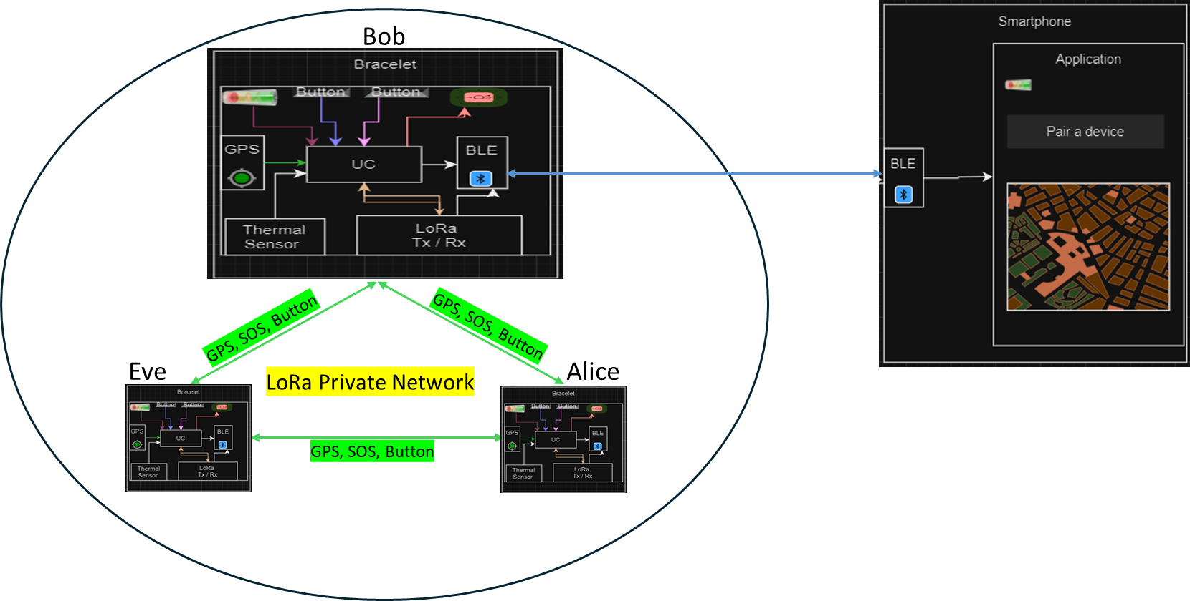
Usage scenario

Slide 5
Technical introduction
State of the art :
Location of group members
Drones | Traditional methods
Satellites | Applications

Slide 6
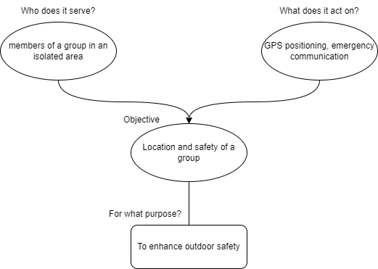
Technical introduction
Functional Analysis

Slide 7
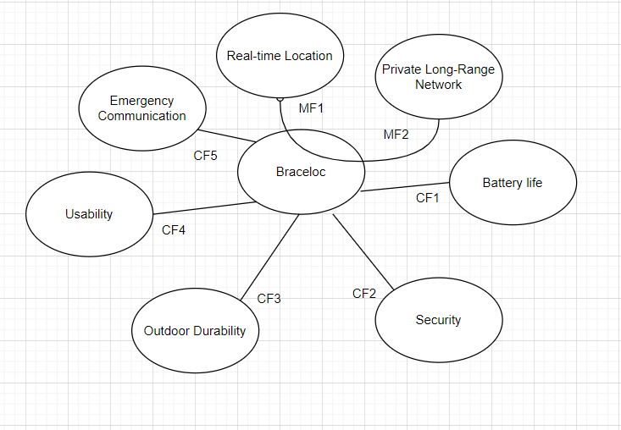
Technical introduction
Functional Analysis:

Slide 8
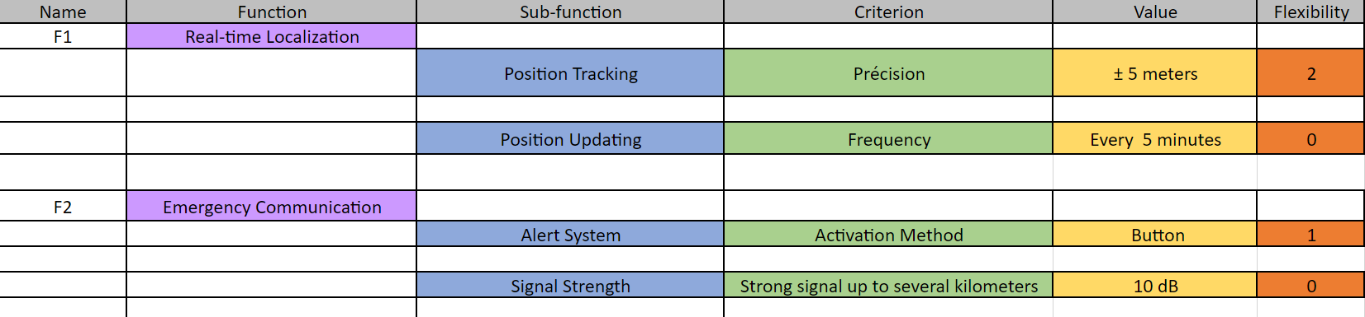
Technical introduction

Slide 9
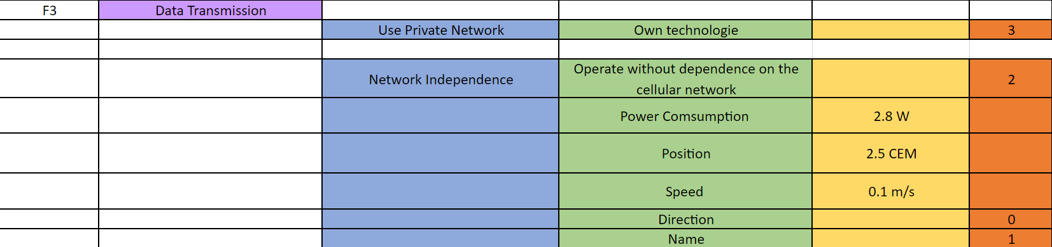
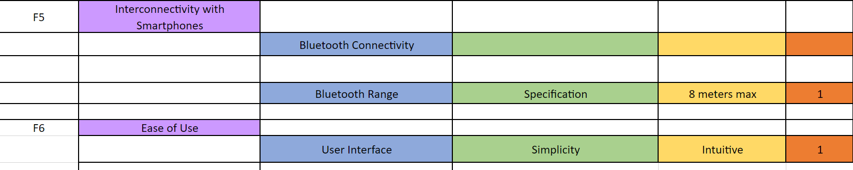
Technical introduction

Slide 10
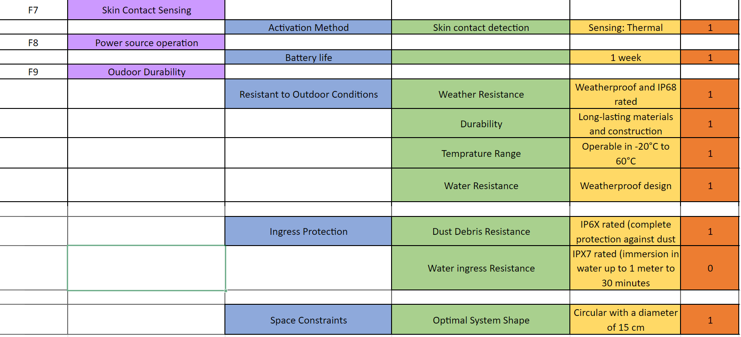
Technical introduction

Slide 11
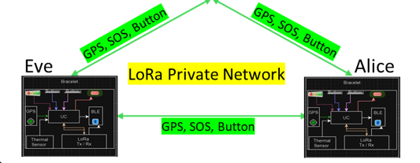
Data transmission

Slide 12
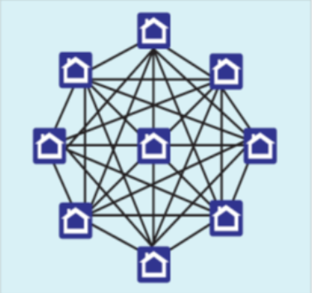
Technical solutions implemented: the mesh network
What is Wireless Mesh Network?
A wireless mesh network is a mesh network created through the connection of wireless access points installed at each network user's locale.
Each network user is also a provider, forwarding data to the next node.
The networking infrastructure is decentralized and simplified because each node need only transmit as far as the next node.

Slide 13

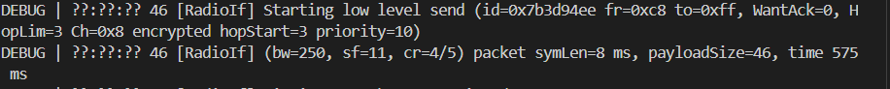
What is a Mesh Network?
Objective : Establish a self-healing, self-configuring LoRa mesh network
for long-range communication : successful
WantAck=0 means no acknowledgment is needed for this message.
HopLim=3 suggests the message can make a maximum of three hops in the network.
ch=0x8 specifies the communication channel number 8.
encrypted indicates the data is encrypted for security.
hopStart=3 and priority=10 show the initial hop count and the message priority level, respectively.
The bandwidth (bw=250) is set to 250 kHz
The spreading factor (sf=11) impacts transmission range and robustness, and the
Coding rate (cr=4/5) relates to signal reliability.

Slide 14
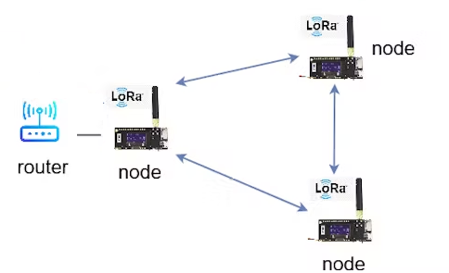
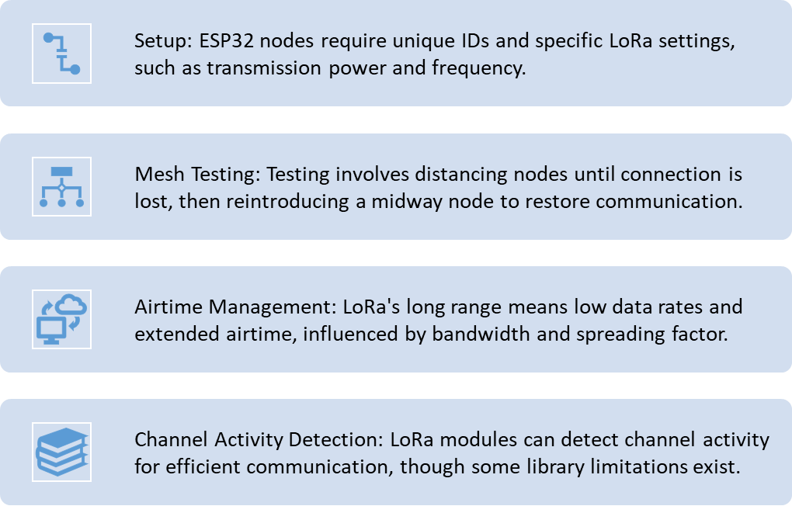
Communication in LoRa Mesh Network

Slide 15
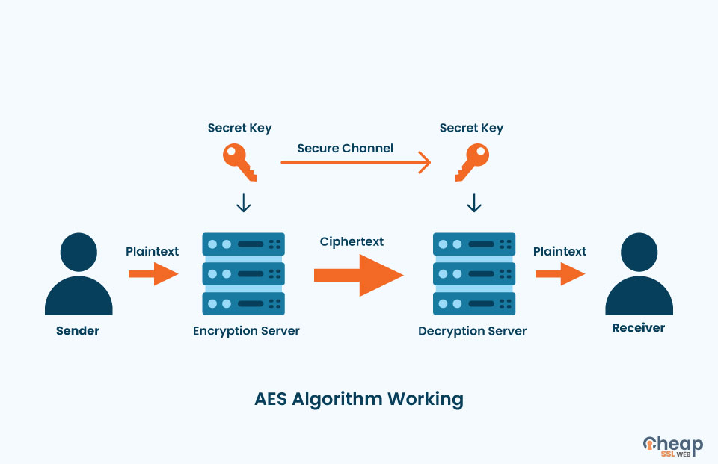
Technical solutions implemented: What about Security
AES algorithm for encrypting data
widely used symmetric encryption for securing data
same key is used for both encrypting and decrypting data
This means that the different connected bracelets will possess the same key to encrypt data when sending and decrypt data when receiving.

Slide 16
Technical solutions implemented: What about Security
Diffie-Hellman for transmitting AES key with RSA encryption
Start
Mod.1
AES key = Ask a user to define a Password
Mod.2
Generate a pair of keys : Private and public key
Generate a pair of keys : Private and public key
Public key Mod. 1
Send Public key to others
Send Public key to others
Public key Mod. 2
Private key Mod.1 + Public key Mod.2 = Key
Private key Mod.2 + Public key Mod.1 = Key
Secure channel = Key + signature
Send AES key using a secure channel
Receive AES key a stock it
AES Key

Slide 17
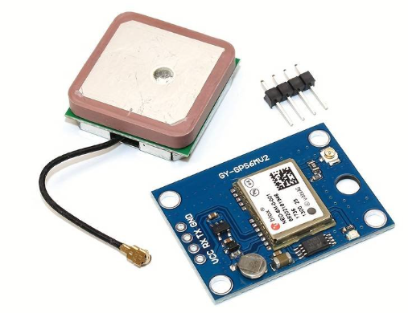
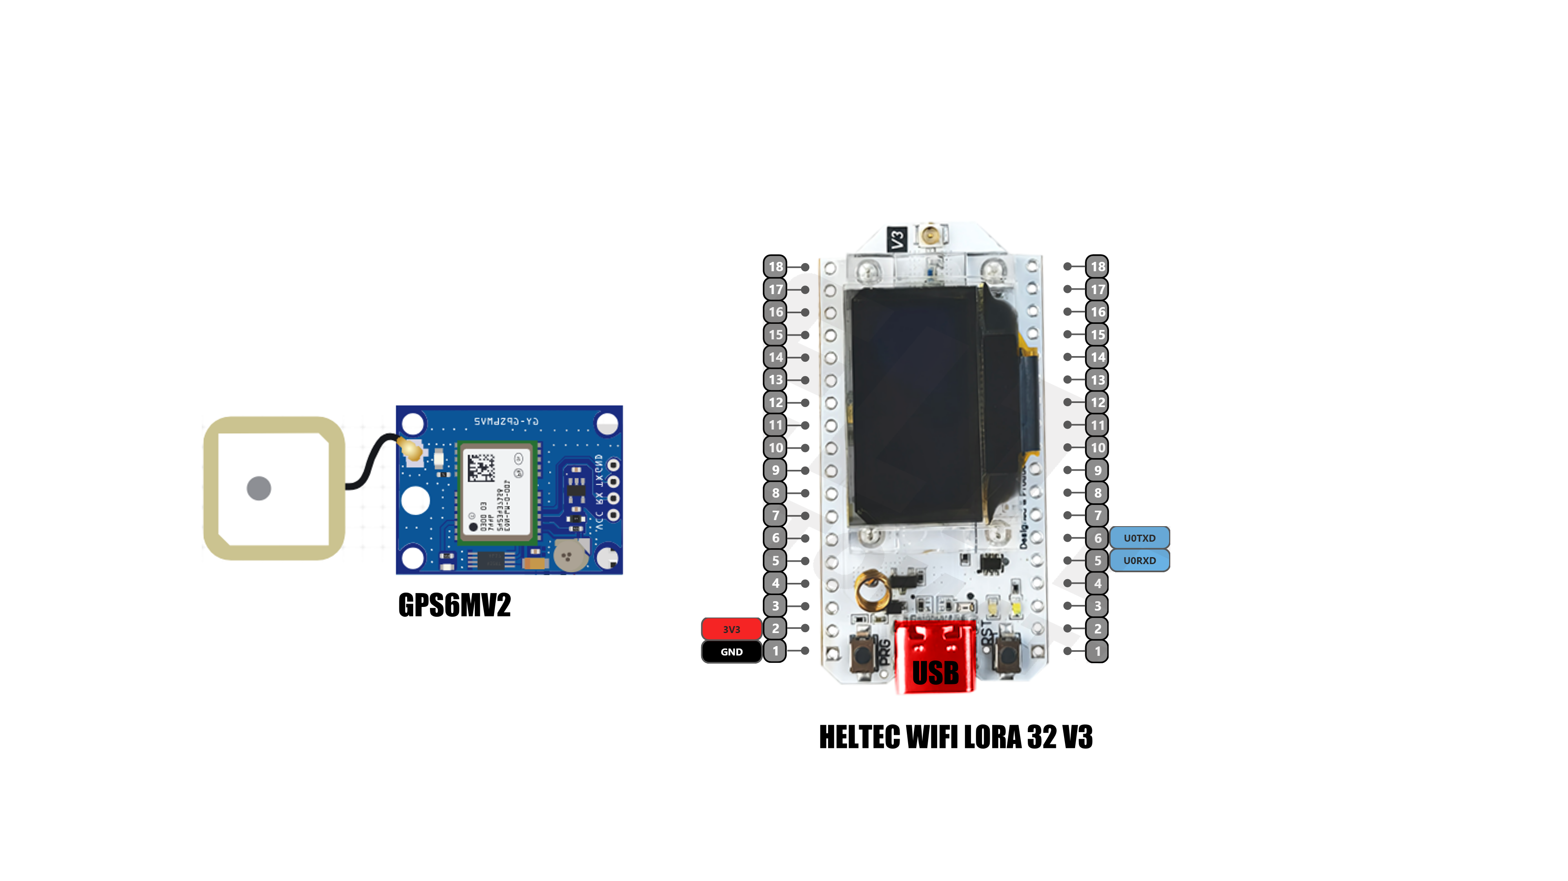
Technical solutions implemented: GPS sensor
Objective: Obtain the GPS coordinates associated with each user.
Communication Interface: UART
Need a backup battery to save the GPS synchronization settings
Frequency: L1, 1575.42 MHz
Default baud rate of 9600 bps
Model : GPS6MV2

Slide 18
Technical solutions implemented: GPS sensor
Communication Interface: UART
Cannot use the RX/TX pins and the USB pin of the Heltec board simultaneously

Slide 19
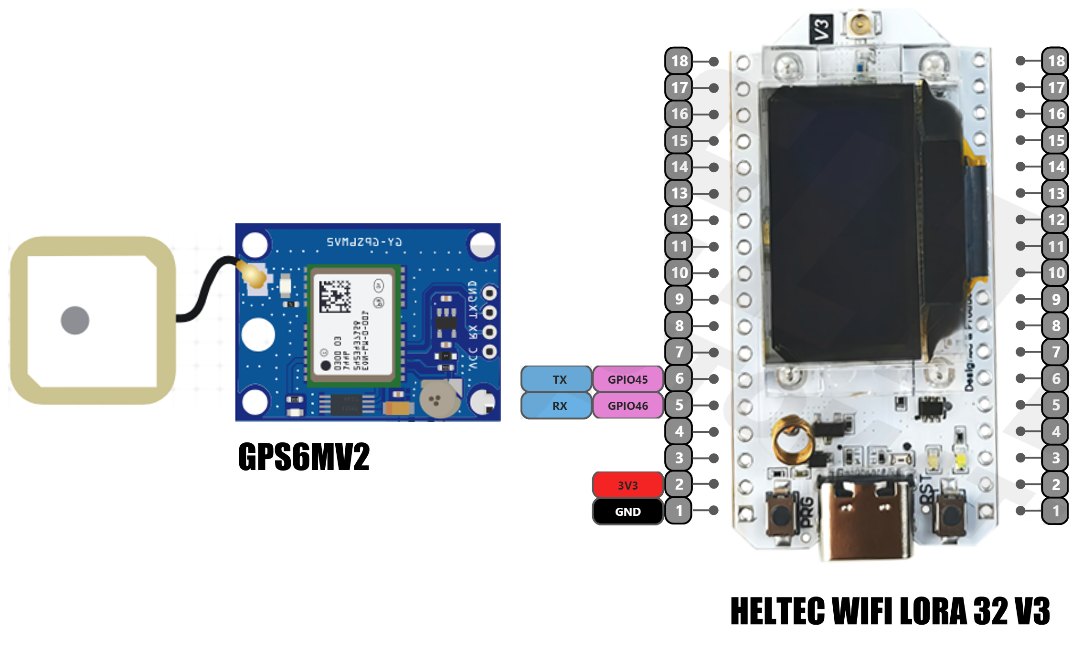
Technical solutions implemented: GPS sensor
We use GPIO 45 & 46 pins to create an RX/TX pin in the software of the Heltec board
-> library.

Slide 20
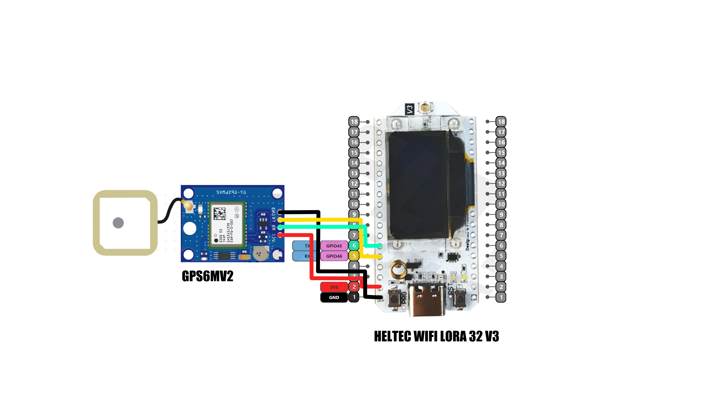
Technical solutions implemented: GPS sensor
We retrieve the latitude and longitude coordinates sent by the GPS
Data obtained from the GPS
Latitude
Longitude

Slide 21
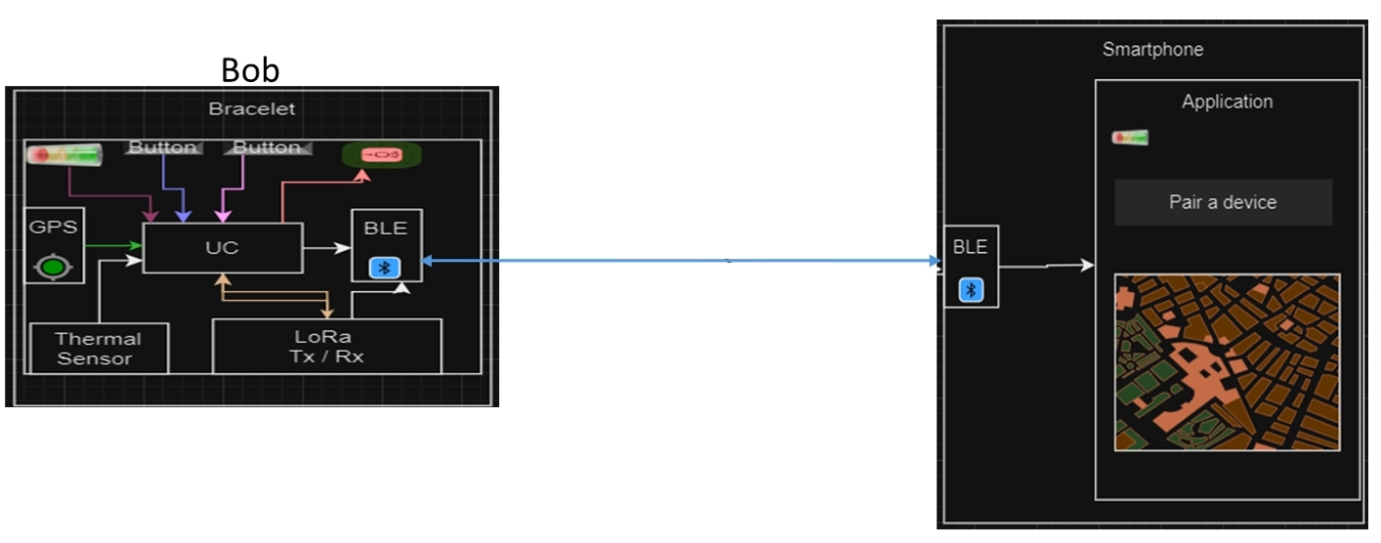
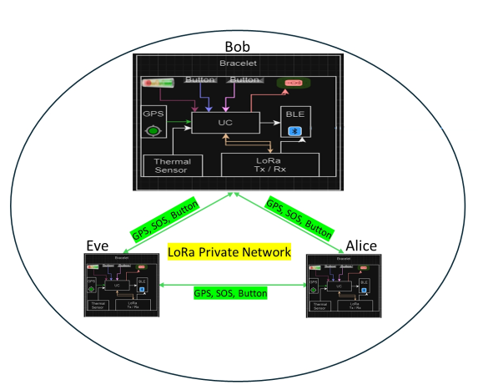

Technical solutions implemented: Smartphone Application + BLE
Objective: Send the GPS coordinates of each user to a smartphone application.
Name
User_Id
Longitude
Latitude
Each member of the same group shares the same following data.
BLE

Slide 22

Technical solutions implemented: Smartphone Application + BLE
The software used to create the mobile application is Braceloc.
Free software for developing Android applications.

Slide 23
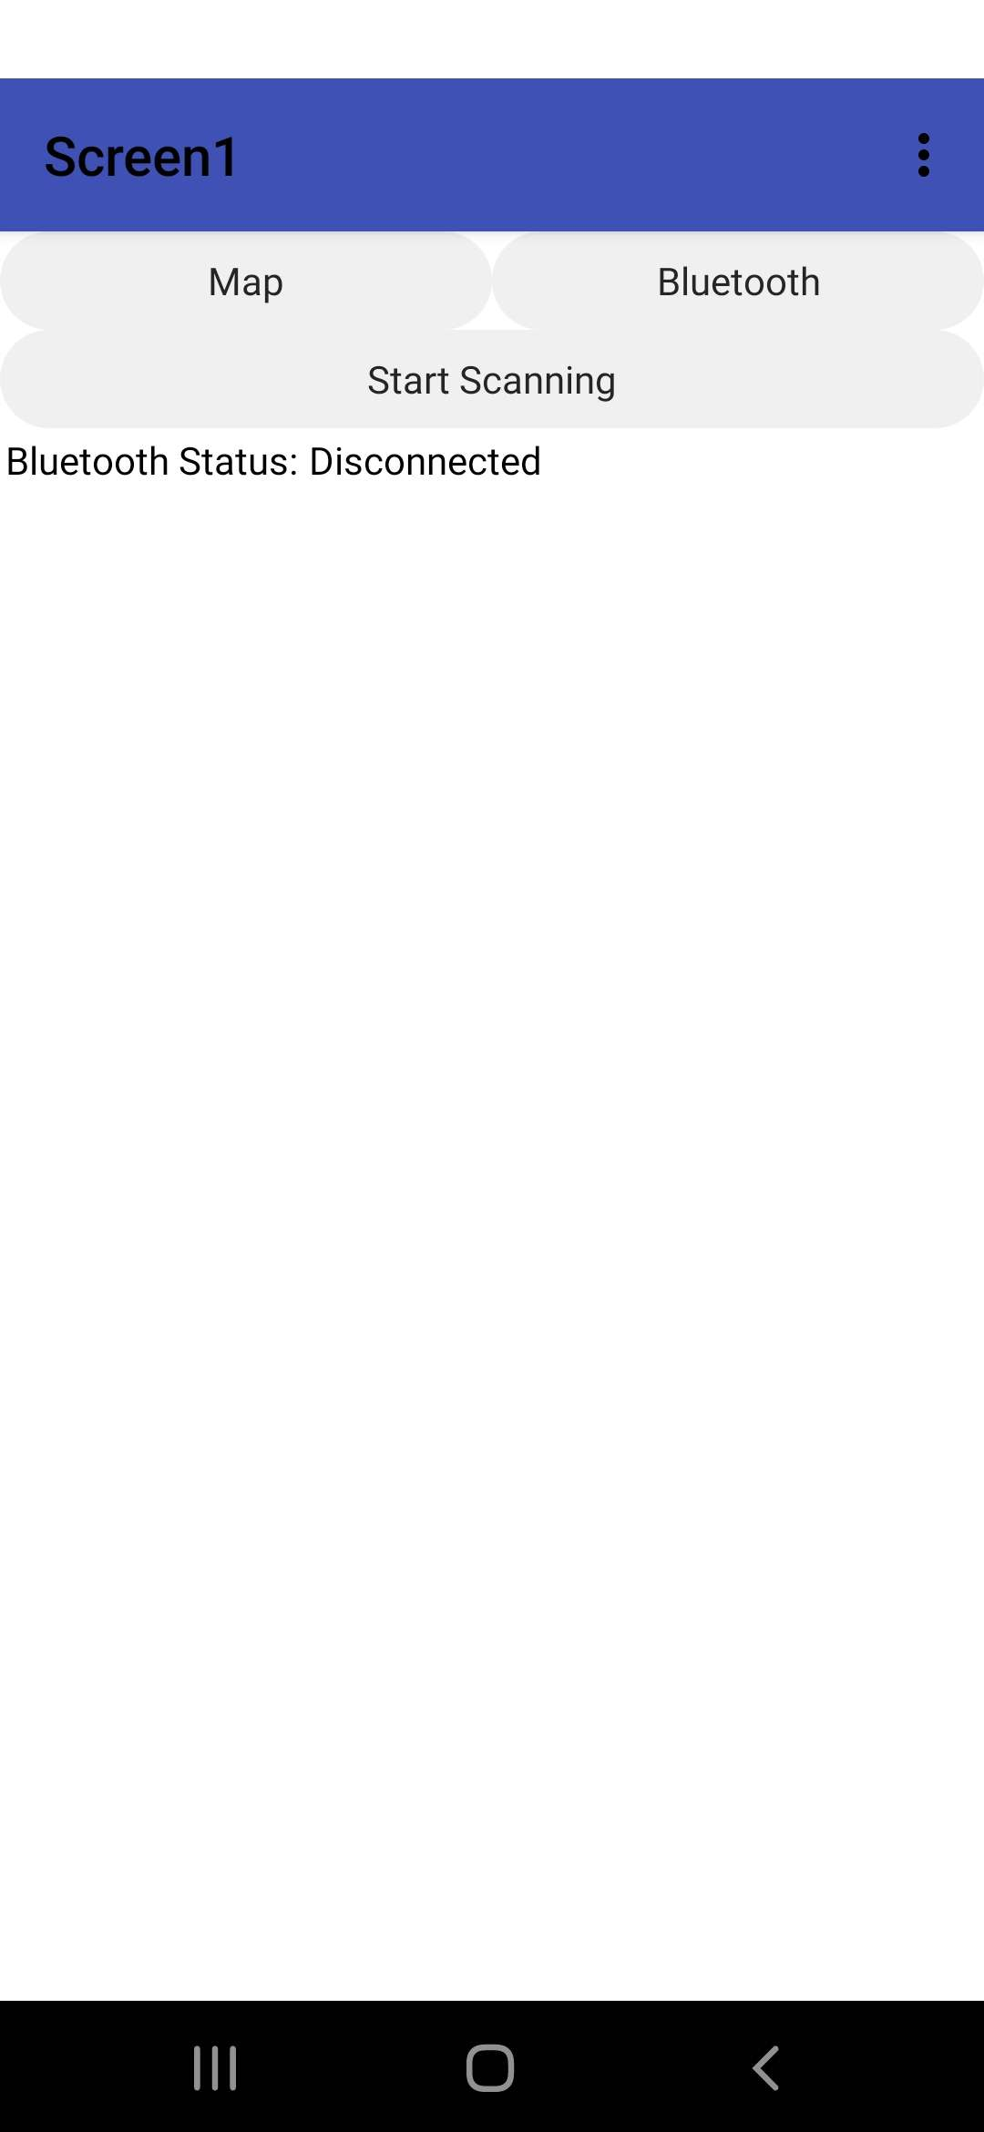
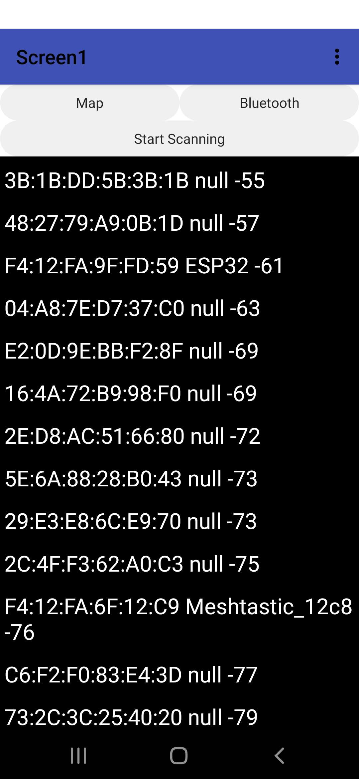
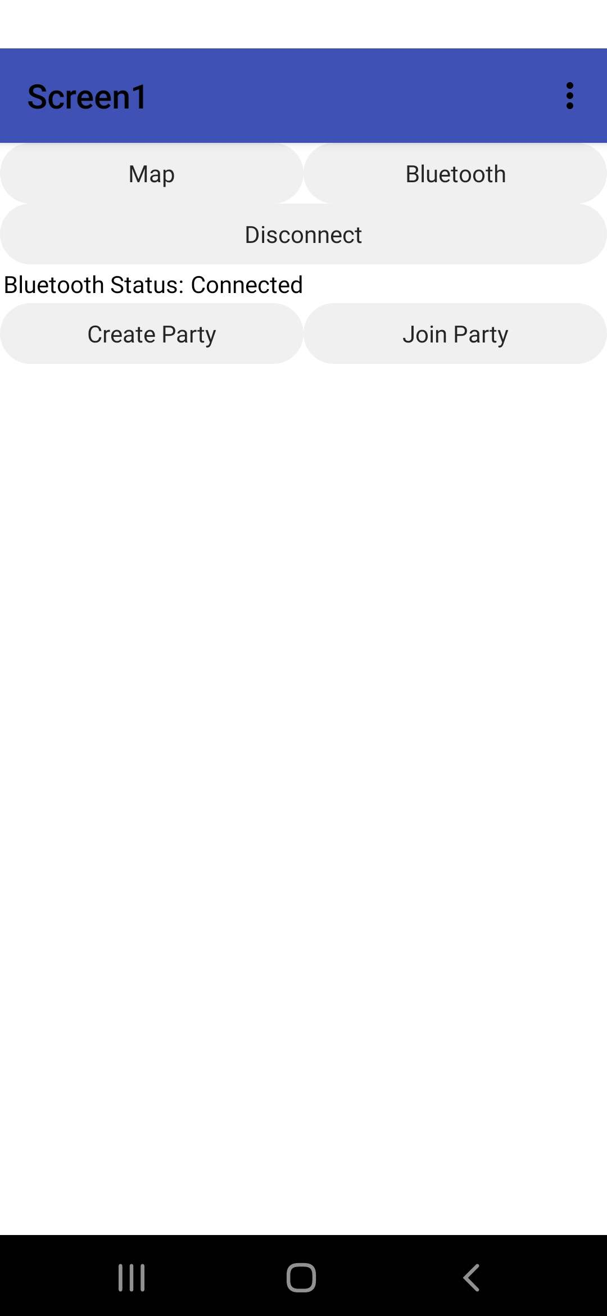
Technical solutions implemented: Smartphone Application + BLE

Slide 24
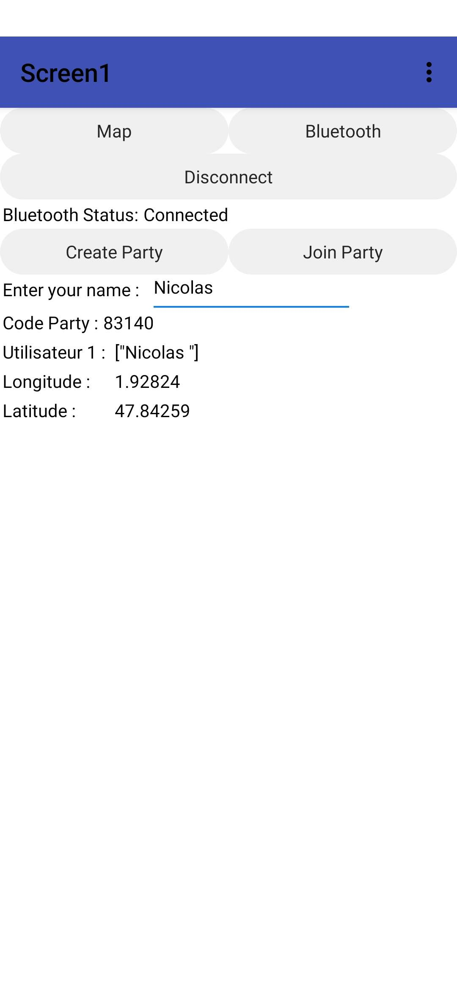
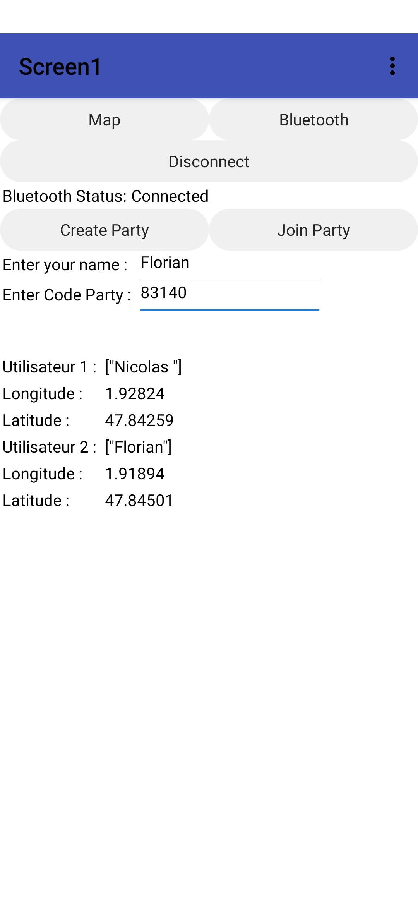
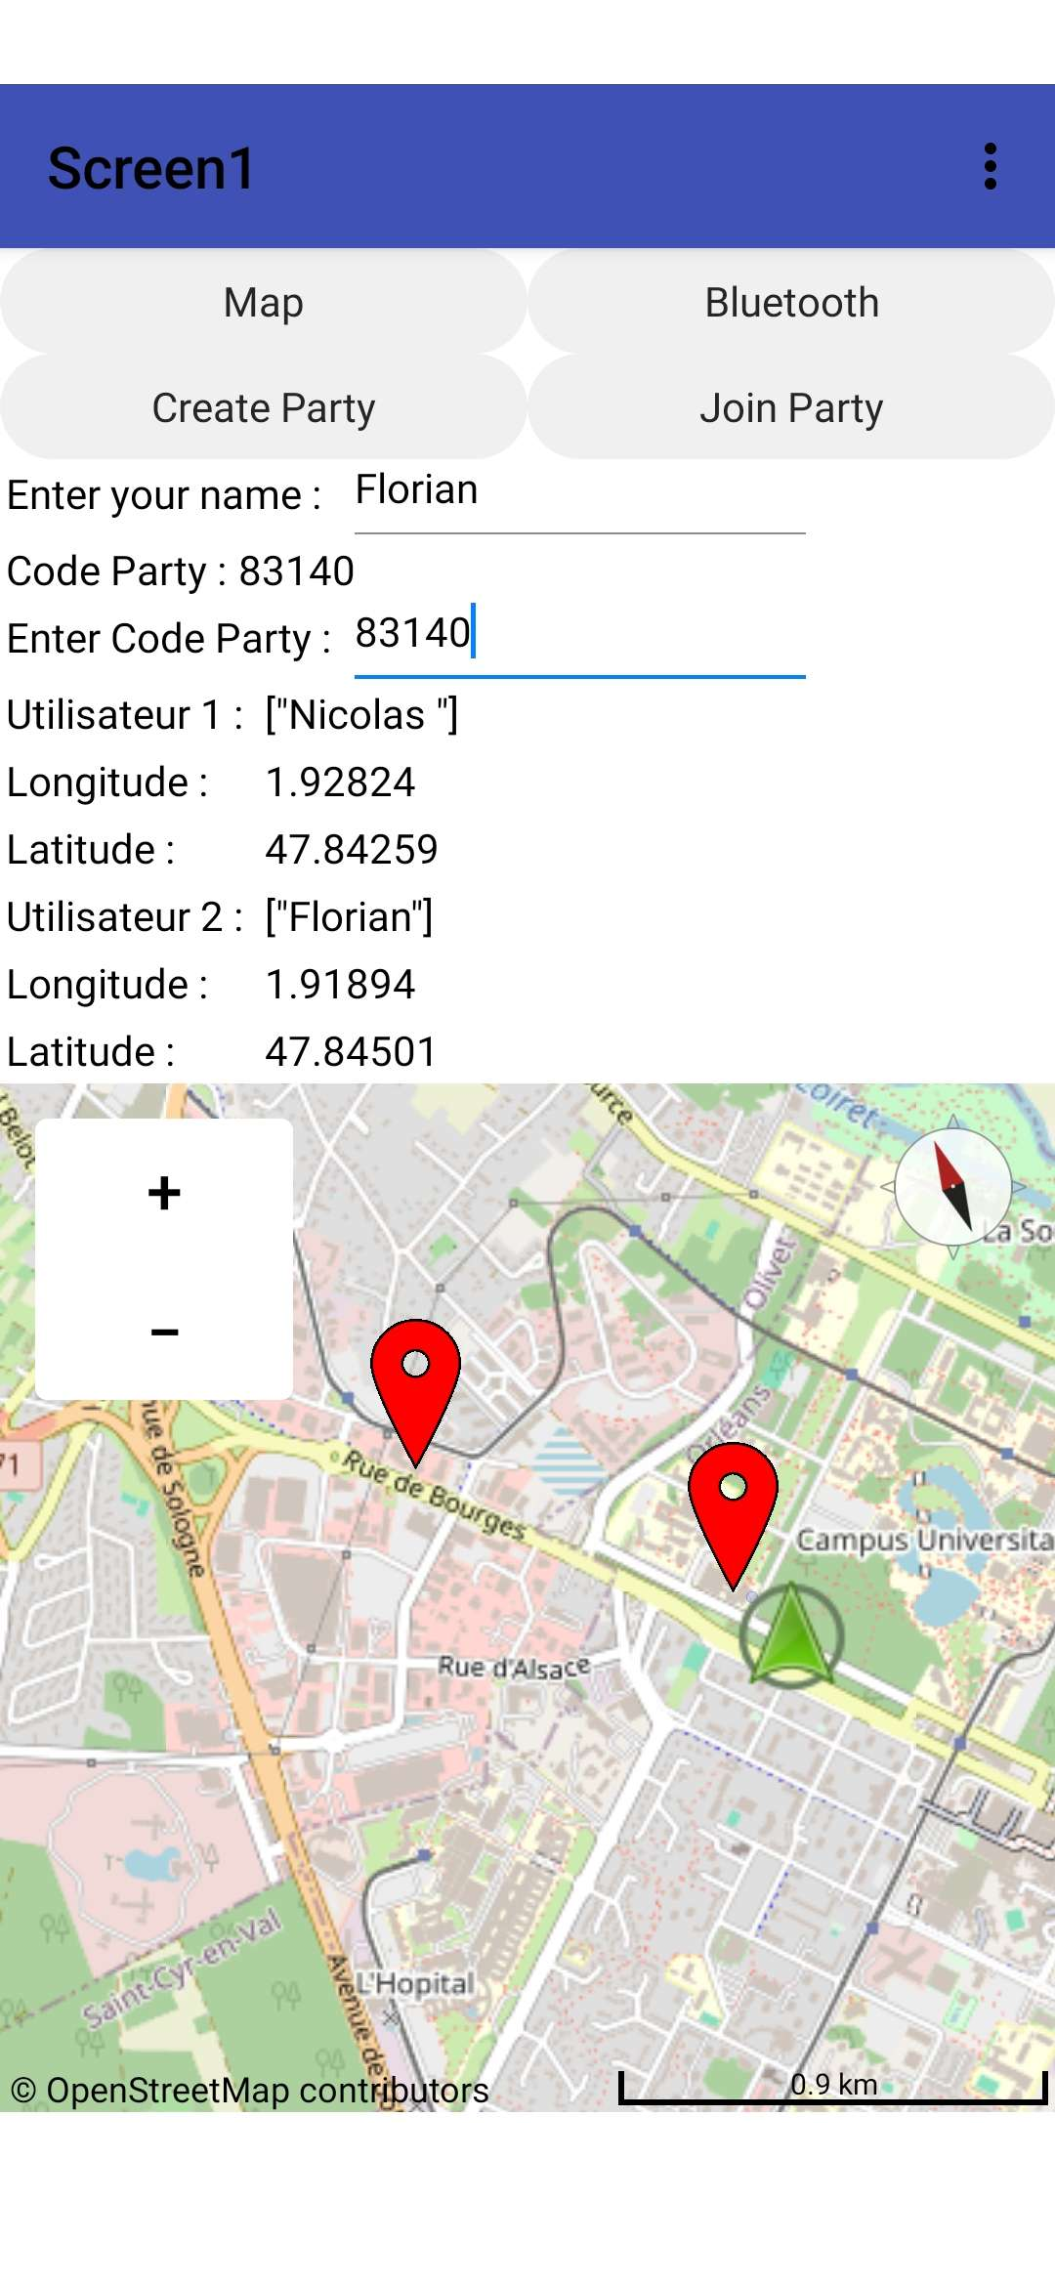
Technical solutions implemented: Smartphone Application + BLE

Slide 25
Task allocation
 | Florian | Nicolas | Helioth
Lora Network | X | X
Mesh Network | X
Data Security |  |  | X
GPS Sensor |  | X
BLE |  | X
Smartphone application |  | X

Slide 26
Conclusion

Slide 27
Thank you for your attention

Slide 28
Annexe

Slide 29
Task allocation LORA
Name | Task | Task validity condition | Start Date | End Date | Project duration (hours). | In charge
 | Installing LoRa Libraries: Use PlatformIO to install the necessary LoRa libraries for our development board | Verification of the correct integration of libraries and dependencies in PlatformIO. | 2/29/2024 | 2/29/2024 | 1
 | Defining LoRa Parameters: Configure LoRa parameters such as frequency, transmission power, data rate, and spreading factor | Validation of configured parameters through data transmission and reception tests. Optimize various parameters to maximize the transmission distance as much as possible | 2/29/2024 | 2/29/2024 | 2
 | Implementation of Basic Code: Start by writing basic code that initializes the LoRa module on each device in the network. Define functions for LoRa message transmission and reception. Implement mesh logic so that each device can relay messages from other devices | Successful development of a basic code initializing LoRa modules on each device in the network. Functional implementation of LoRa message transmission and reception functions. Successful integration of mesh logic to enable message relay between devices. | 3/1/2024 | 3/1/2024 | 4
 | Network Topology Management: Design a mechanism to manage the network topology, including dynamic addition and removal of nodes. Ensure that each node is aware of its neighbors to transmit messages efficiently within the mesh network |  | 3/1/2024 | 3/1/2024 | 3

Slide 30
Task allocation GPS Sensor
Name | Task | Task validity condition | Start Date | End Date | Project duration (hours). | In charge
GPS sensor. | Initialization of the GPS sensor: Write the necessary code to initialize the GPS sensor at the startup of the Heltec WiFi 32 LoRa module. Send the appropriate initialization commands to the GPS sensor via the serial port to set it in operational mode. | Use the serial monitor to check the connection between the GPS sensor and the Heltec WiFi 32 LoRa module | 2/29/2024 | 2/29/2024 | 1 | Florian
 | Receive and process GPS data: Develop the code to receive position data transmitted by the GPS sensor via the serial port. Analyze the received data to extract position information such as latitude, longitude, and optionally speed and direction. | Validate the accuracy of the position data provided by the GPS sensor by comparing it with the datasheet. | 2/29/2024 | 2/29/2024 | 1 | Florian

Slide 31
Task allocation Smartphone Application + BLE
Name | Task | Task validity condition | Start Date | End Date | Project duration (hours). | In charge
Smartphone Application + (BLE) | Create a mobile application that will allow connecting to Braceloc bracelets via Bluetooth Low Energy (BLE). Design an intuitive user interface to visualize the positions of the group and manage bracelet settings. | Connection test to verify that the application can detect and connect to Braceloc bracelets via Bluetooth BLE, ensuring that the connection is stable and reliable. | 3/13/2024 | 4/23/2024 | 27 | Nicolas Florian
 | Integrate configuration and pairing functionalities for the bracelets into the application. | Verification through authentication tests to confirm that the application can check the credentials of Braceloc bracelets during the pairing process, ensuring that only authorized bracelets can be paired with the application. | 3/23/2024 | 4/6/2024 | 7
 | Integrate into the application the functionality to connect with heltec wifi lora v3 via Bluetooth Low Energy (BLE). | Conduct tests on the stability and reliability of the Bluetooth Low Energy (BLE) connection. | 4/6/2024 | 4/9/2024 | 3
 | Program the application to receive and display the position data transmitted by the bracelets. | Verify through tests to ensure that the received position data is correctly extracted from the BLE data stream and interpreted by the application. | 4/9/2024 | 4/23/2024 | 17

Slide 32
Task allocation Security of data transmission
Name | Task | Task validity condition | Start Date | End Date | Project duration (hours). | In charge
Security of data transmission | Configuration of security parameters: Defining appropriate security parameters, such as encryption algorithms, encryption keys, identity verification parameters, and authentication methods. |  | 2/28/2024 | 3/6/2024 | 2 | Helioth
 | Encryption Implementation: Integrating encryption mechanisms within the application and the bracelets to encrypt the exchanged data. |  | 3/12/2024 | 3/16/2024 | 2 | Helioth
 | Encryption Key Management: Establishing a secure system for generating, storing, and managing encryption keys. Utilizing key management protocols such as Key Management Interoperability Protocol (KMIP) to ensure key security. | Verify that it is impossible to decode the transmitted data (Key length and complexity of encryption keys).
 | Device Authentication: Develop authentication mechanisms to verify the identity of Bluetooth BLE devices during the establishment of the connection. This may include the use of digital certificates or unique identifiers for each device. | Verify that unauthorized connection attempts are rejected. | 3/16/2024 | 3/18/2024 | 1 | Helioth

Slide 33
Task allocation Skin Detection Sensor
Name | Task | Task validity condition | Start Date | End Date | Project duration (hours). | In charge
Skin Detection Sensor |  |  | 3/11/2024 | 3/25/2024 | 23 | Nicolas
 | Learn the operation of the BM280 sensor |  | 3/11/2024 | 3/12/2024 | 3
 | Create a prototype circuit for using the BM280 sensor | Sending data to the ESP32 | 3/18/2024 | 3/20/2024 | 4
 | Write code to retrieve data from the sensor (temperature, humidity, pressure). | Consistency between the sensor data and the actual values. | 3/18/2024 | 3/22/2024 | 8
 | Finding parameters for simulating the wearing of the bracelet to determine if it is properly worn by the user. | When in contact with the skin, the sensor should send information to the microcontroller (uC), which should consider that the bracelet is being worn. | 3/18/2024 | 3/25/2024 | 8

